Slide 1
Website Layout

Slide 2
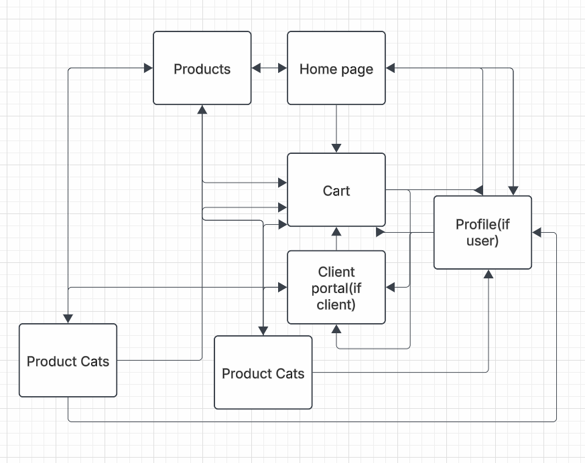

Slide 3
Home Page
Picture, Memo, Goals
Product page link

Slide 4
products
3 categories including pictures, links to product category page

Slide 5
Product category page
Specifies category with description
Item photos and prices
buy

Slide 6
Cart
Items in cart
Remove
Update quantity
Sign in or guest

Slide 7
profile
Current orders
Past orders
Account info
Cart

Slide 8
Client portal
Order Tracking
Inventory tracking
Inventory update
New additions

